Slide 1
Merton’s Jump-Diffusion model: Delta hedging and model calibration
Pranava C Jayanti
Quant Finance Bootcamp (Fall 2025)
The Erdòs Institute

Slide 2
Merton’s Jump-Diffusion model
$$dS_{t}=\left(μ+r\right)S_{t}dt+σS_{t}dW_{t}+\left(Y−1\right)S_{t}dN_{t}$$
Asset pricing model involving Geometric Brownian Motion with “kicks” to describe sudden market crashes/shocks.
Drift-Diffusion: The standard GBM smooth path.
Jump process: A random Poisson process that models the frequency (λ) and size (α,δ) of sudden price jumps.
MJD provides a much more realistic simulation of asset prices.
$$S_{t}=S_{0}e^{\left(μ−λk+r−\frac{σ^{2}}{2}\right)t+N(nα,σ^{2}t+nδ^{2})}$$

Slide 3
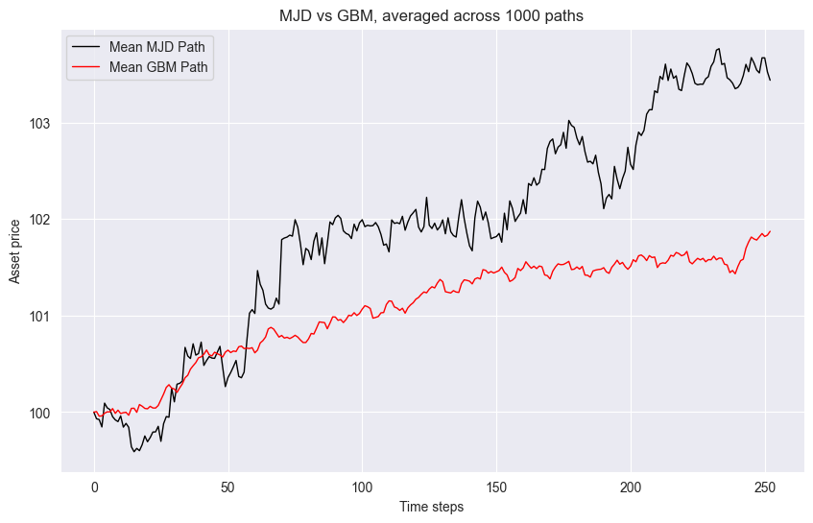
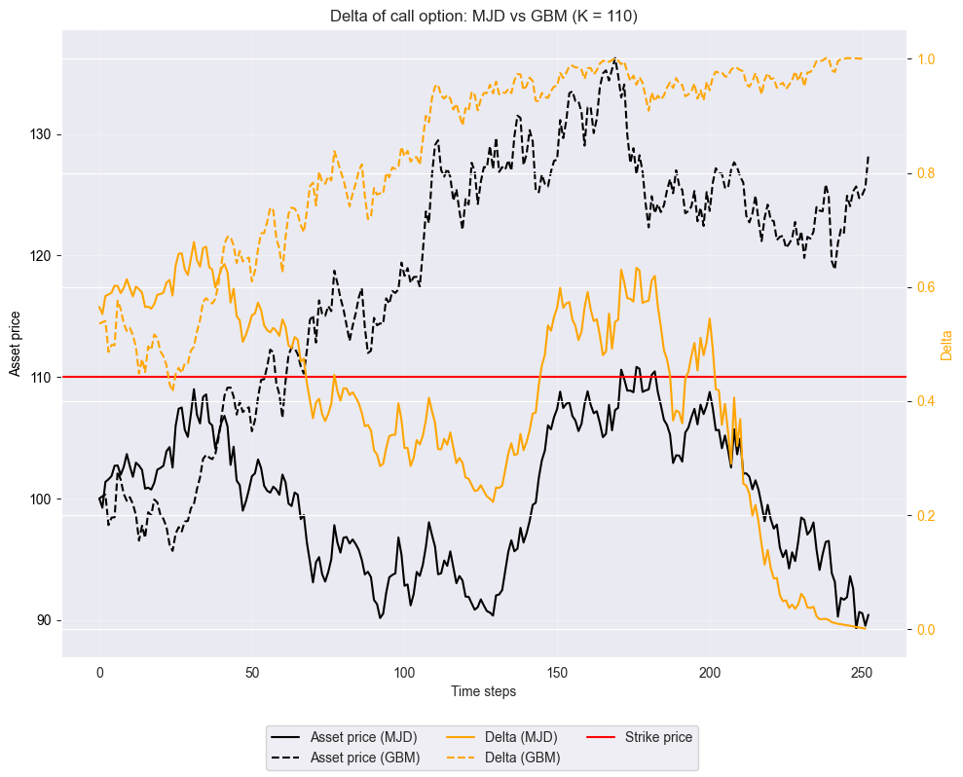

MJD vs GBM: $S_{t}$ and $Δ_{C_{0}}$

Slide 4
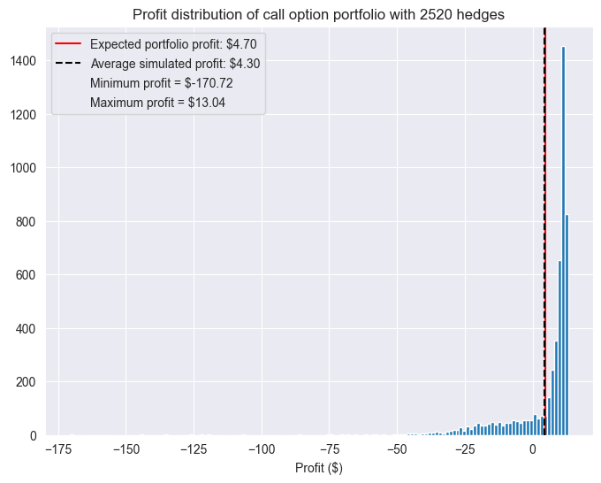
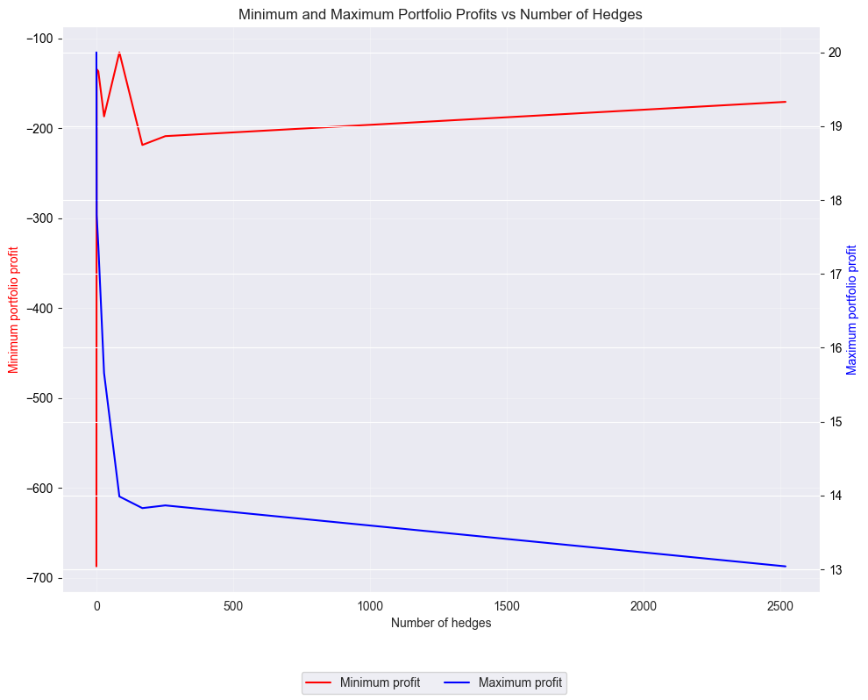
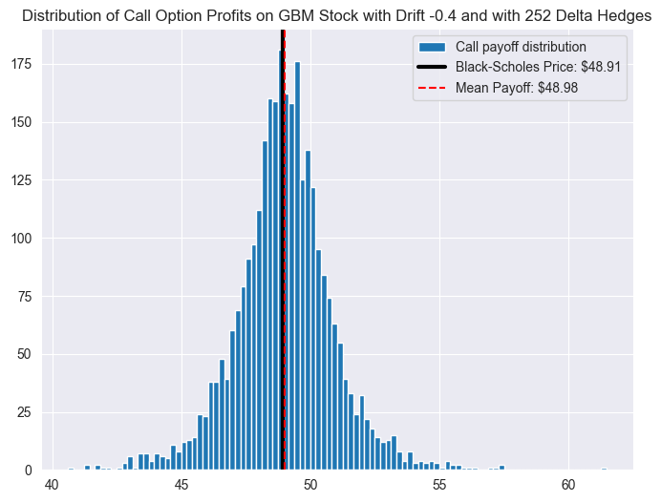
MJD and Delta Hedging

Slide 5
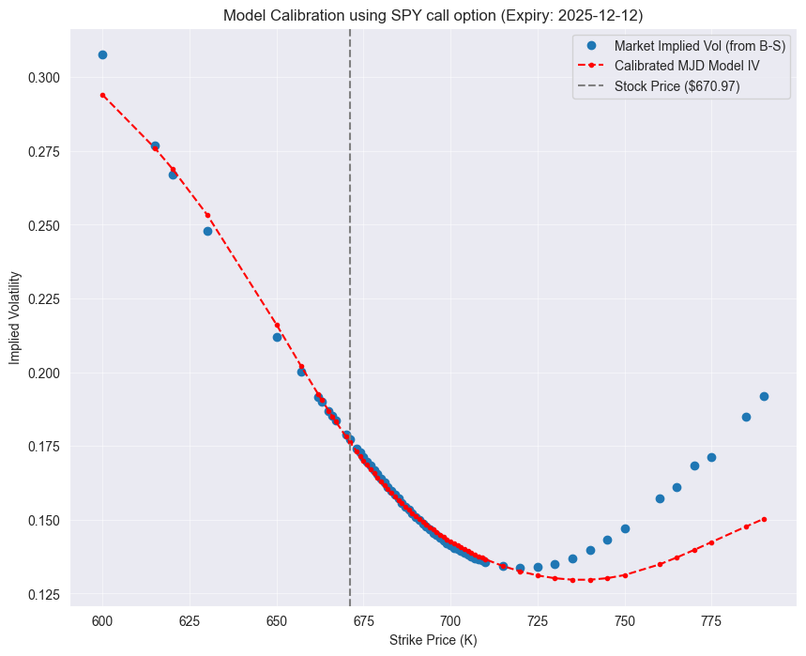
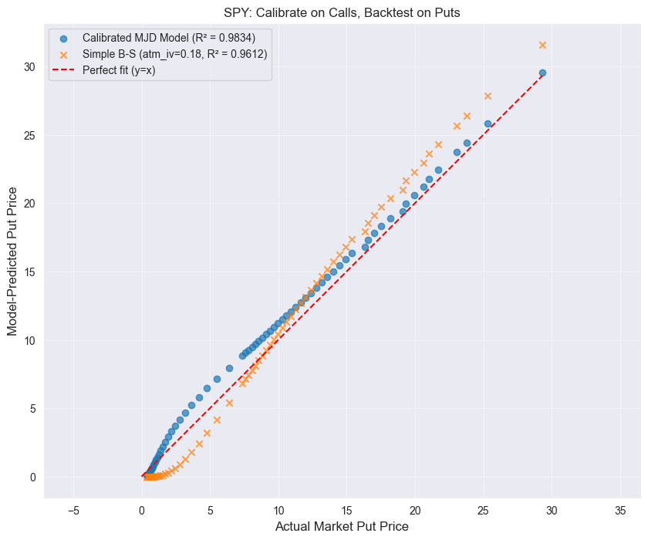
Calibration and Backtesting to market data

Slide 6
Conclusions & Hedging Implications
Pricing: MJD is a superior model for pricing European options as it successfully captures the volatility smile, which is a persistent feature of real markets.
Prediction: The model demonstrates strong predictive power, accurately pricing unseen put options after being trained only on calls.
Hedging:
  While Delta hedging is possible, it is imperfect under MJD.
  The model's "jump risk" is systemic and cannot be hedged away simply by trading the underlying asset.
  Provides a theoretical explanation for why real-world "delta-neutral" portfolios still experience large, sudden losses and gains (i.e., "fat tails").

